Slide 1
RNA-Seq Module
BD2K
JAX
2018

Slide 2
RNA-Seq Introduction

Slide 3
RNA
http://www.phschool.com

Slide 4
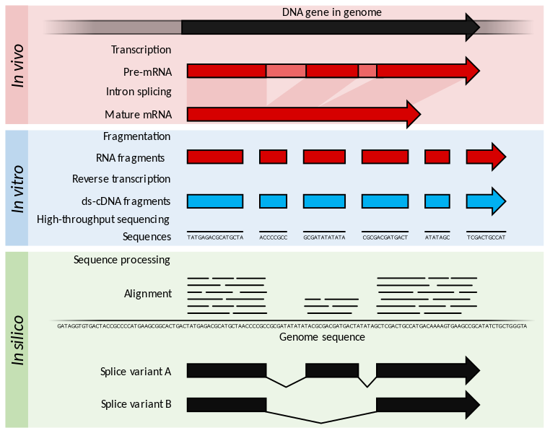
RNA Sequencing (RNA-Seq)
Wikimedia Commons

Slide 5
Applications of RNA-seq
Normal
Cancer
Differential Gene Expression analysis
Steve Munger, 2017

Slide 6
Applications of RNA-seq
Evidence from
RNA-seq
Annotated gene
Novel exon discovery
Steve Munger, 2017

Slide 7
Applications of RNA-seq
exon1
exon2
exon3
Isoform 1
Isoform 2
Alternative splicing
Steve Munger, 2017

Slide 8
Applications of RNA-seq
A
ATGCTCA
AGCTA
A
AGCTA
TAGATGCTCA
AGCTAAT
GCTCA
A
TGCTCA
A
AGCTAA
A
ATGCTCA
AGCTA
A
AGCTA
TAGATGCTCA
AGCTAATC
A
ATGCTCA
A
AGCTA
ATGCTCA
Mom
TAGATGCTCA
A
AGCTAATCCTAG
Dad
TAGATGCTCA
G
AGCTAATCCTAG
G
AGCTATCC
ATGCTCA
ATGCTCA
G
AGCTATCCT
G
AGCTA
ATGCTCA
Allele-Specific gene Expression (ASE)
Preferential expression of one allele over the other.
Steve Munger, 2017

Slide 9
Dündar et al. (2015)

Slide 10
RNA-seq Work Flow
Study Design
RNA isolation/ Library Prep
Sequencing Reads (SE or PE)
Aligned Reads
Quantified isoform and gene expression

Slide 11
RNA-Seq
Total RNA
mRNA
mRNA after
fragmentation
cDNA
Adaptors ligated
to cDNA
Single/ Paired End
Sequencing

Slide 12
Know your experiments
How was the library constructed? (total RNA, polyA selection, rRNA depletion or RNA capture) – libraries produced by different methods are not comparable
Single or pair end – mapping differently
Unstranded or forward/reversed – critical for quantification
Number of replicates – At least 2
Read depth and read length – depend on the experimental goal (ENCODE_guideline)

Slide 13
RNA-seq Work Flow
Study Design
RNA isolation/ Library Prep
Sequencing Reads (SE or PE)
Aligned Reads
Quantified isoform and gene expression

Slide 14
Millions and millions of reads…
@HISEQ2000_0074:8:1101:7544:2225#TAGCTT/1
TCACCCGTAAGGTAACAAACCGAAAGTATCCAAAGCTAAAAGAAGTGGACGACGTGCTTGGTGGAGCAGCTGCATG
+
CCCFFFFFHHHHDHHJJJJJJJJIJJ?FGIIIJJJJJJIJJJJJJFHIJJJIJHHHFFFFD>AC?B??C?ACCAC>BB<<<>C@CCCACCCDCCIJ
@HISEQ2000_0074:8:1101:7544:2225#TAGCTT/1
The member of a pair
Instrument: run/flowcell id
Flowcell lane and tile number
Index Sequence
X-Y Coordinate in flowcell
Q = -10 log₁₀ P
10 indicates 1 in 10 chance of error
20 indicates 1 in 100,
30 indicates 1 in 1000,
Phred Score:
Steve Munger, 2017

Slide 15


Quality Control: How to tell if your data is clean
FASTX-Toolkit
http://hannonlab.cshl.edu/fastx_toolkit/
FastQC
http://www.bioinformatics.babraham.ac.uk/projects/fastqc/
NGS Data Preprocessing

Slide 16
Trim or not trim?
Signal/noise -> Preprocessing can remove low-quality “noise”, and adapters but the cost is information loss.
Some uniformly low-quality reads map uniquely to the genome.
Trimming reads to remove lower quality ends can adversely affect alignment, especially if aligning to the genome and the read spans a splice site.
Most aligners can take quality scores into consideration.
Currently, we do not recommend preprocessing reads aside from removing uniformly low quality samples.
Debate: http://www.ecseq.com/support/ngs/trimming-adapter-sequences-is-it-necessary

Slide 17
RNA-seq Work Flow
Study Design
RNA isolation/ Library Prep
Sequencing Reads (SE or PE)
Aligned Reads
Quantified isoform and gene expression
17

Slide 18
Alignment 101
100bp Read
ACATGCTGCGGA
Chr 3
ACATGCTGCGGA
Chr 2
Chr 1
Steve Munger, 2017

Slide 19
The perfect read: 1 read = 1 unique alignment.
100bp Read
ACATGCTGCGGA
✓
Chr 3
ACATGCTGCGGA
Chr 2
Chr 1
Steve Munger, 2017

Slide 20
Some reads will align equally well to multiple locations. “Multireads”
100bp Read
✗
ACATGCTGCGGA
✓
ACATGCTGCGGA
✗
ACATGCTGCGGA
Ignore them
Weight them
Tools: mmquant, MMR, seqcluster, etc.
1 read
3 valid alignments
Only 1 alignment is correct
ACATGCTGCGGA
Steve Munger, 2017

Slide 21
Aligning Millions of Short Sequence Reads
Gene A
Gene B
Aligners: STAR, HISAT2, TopHat2
Notes:
Different aligner have different strategies to align and detect alternative splicing.

Slide 22
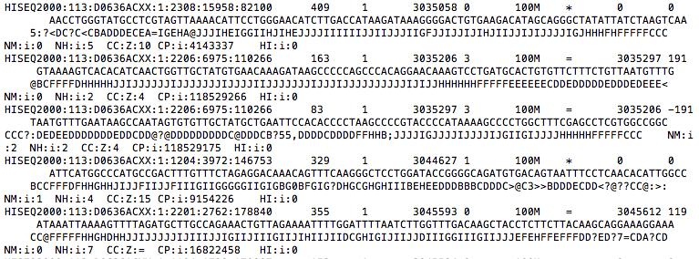
Output of most aligners: Bam/Sam file of reads and genome positions
Tools to handle Bam/Sam files: samtools, bamUtil

Slide 23
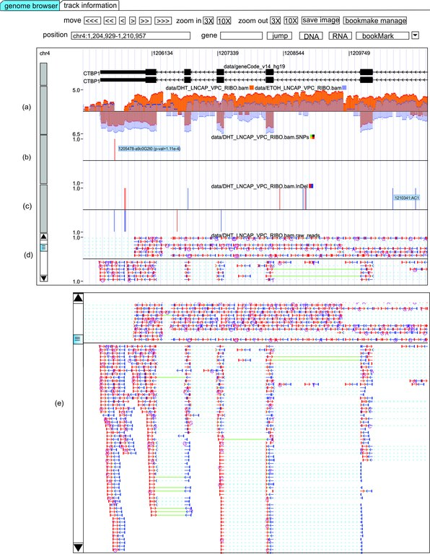
Visualization of alignment data (BAM/SAM)
Genome browsers – IGV and RNASeqBrowser
Integrative Genome Viewer (IGV)
http://software.broadinstitute.org/software/igv/download
RNASeqBrowser
http://www.australianprostatecentre.org/research/software/rnaseqbrowser

Slide 24
RNA-seq Work Flow
Study Design
RNA isolation/ Library Prep
Sequencing Reads (SE or PE)
Aligned Reads
Quantified isoform and gene expression
24

Slide 25
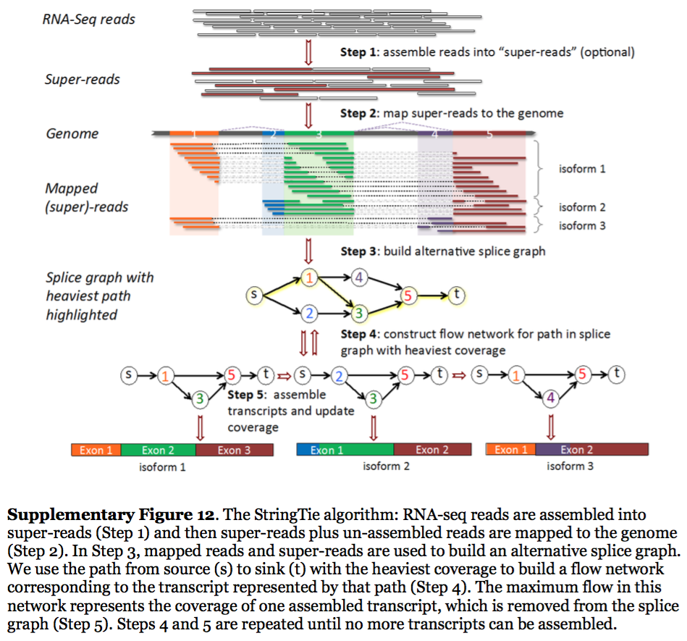
Transcript quantification
StringTie reconstruct transcripts from spliced read alignments generated by previously mentioned aligners
* Sailfish, Kallisto and Salmon align reads to annotated transcriptome sequences
Pertea, 2015

Slide 26
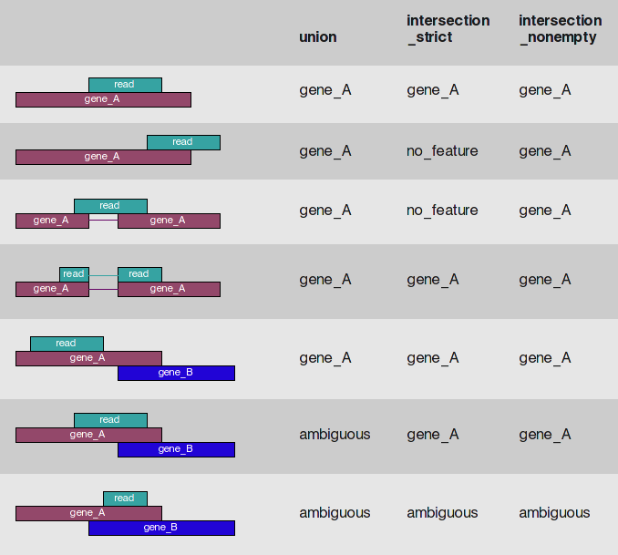
Gene expression
HTseq-count read/feature overlap modes
* Another popular tool: featureCounts (http://bioinf.wehi.edu.au/featureCounts/)
HTseq-count documentation

Slide 27
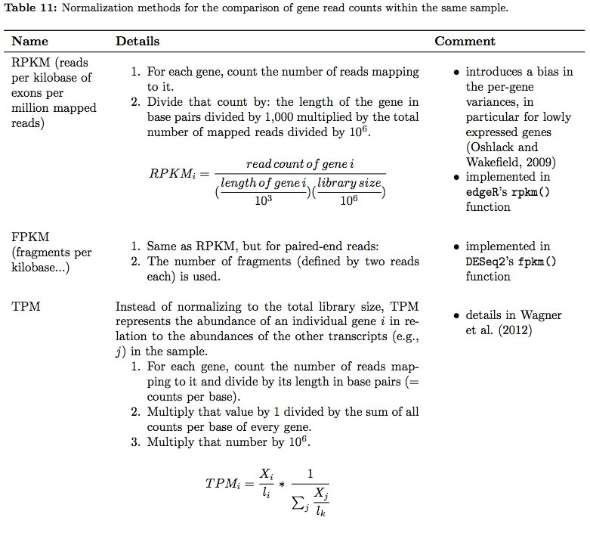
Expression Abundance: Counts, RPKM/FPKM, TPM
* Raw counts are required input for differential analysis by DESeq2 and EdgeR
Good for comparison within one sample but not for cross sample comparison
Dündar et al. 2015

Slide 28
More downstream analysis
Differential expression analysis – DESeq2, EdgeR, and limma-voom (Schurch et al. 2015 for reviews of DE tools)
Gene set enrichment analysis i.e. Gene Ontology (GO) – GOrilla, DAVID, g:profiler
Network-based - GeneMania

Slide 29
Interactive web-based tools
Galaxy (https://usegalaxy.org)
GenomeSpace (http://www.genomespace.org)
Degust: Perform RNA-seq analysis and visualization (http://degust.erc.monash.edu/degust-old/index.html)

Slide 30
Where to get the data?
GenBank (http://www.ncbi.nlm.nih.gov/genbank/)
ENA (https://www.ebi.ac.uk/ena/)
DDBJ (http://www.ddbj.nig.ac.jp/intro-e.html)
ENCODE (https://www.encodeproject.org)

Slide 31
RNA-Seq is still evolving
Single cell
Longer reads
Nascent RNA-Seq
“RNA-Seq is not a mature technology. It is undergoing rapid evolution of biochemistry of sample preparation; of sequencing platforms; of computational pipelines; and of subsequent analysis methods that include statistical treatments and transcript model building.” From ENCODE RNA-Seq analysis guidelines
Keep updated

Slide 32
Resources
https://www.ebi.ac.uk/gxa/home
https://www.ncbi.nlm.nih.gov/gds
https://portal.gdc.cancer.gov
https://www.ebi.ac.uk/arrayexpress/

Slide 33
http://cosi.iscb.org/wiki/Education:Home

Slide 34
RNA-Seq hands-on

Slide 35
Outline
Prepare data
Alignment
Count feature
DE analysis
Gene set enrichment analysis

Slide 36
Background

Slide 37
Background
Pax6

Slide 38
Data fact
Data
Poly-A selected
Reverse stranded

Slide 39
Open up galaxy …

